Slide 1
ATAI
Advanced Techniqueof Artificial Intelligence
ATAI
ChongqingUniversity _{AdvancedTechniqueof}
of Technology Artificial Intelligence
Chongqing University of
Technology
Chongqing University ^{ATAI}
_{of Technology} Advanced Techniqueof
Artificial Intelligence
Chongqing University of Technology
Chongqing University of Technology
A New Token Mixup Multimodal Data Augmentation for
Multimodal Sentiment Analysis
Code:None
2023.11.30
•ChongQing
—— WWW 2023
Reported by YaoChen Li
1

Slide 2
ATAI
AdvancedTechniqueof
Artificial Intelligence
ATAI
ChongqingUniversity _{AdvancedTechniqueof}
of Technology Artificial Intelligence
ChongqingUniversity of Technology
Motivation
(1) Existing methods for Multimodal Sentiment Analysis (MSA) mainly
focus on integrating multimodal data efectively on limited multimodal data. Learning more informative multimodal representation often relies on large-scale labeled datasets, which are difficult and unrealistic to obtain.
(2) Data augmentation training strategy has achieved great success to improve
model performance in multiple computer vision (CV) and natural language
processing (NLP) tasks. However, it is not straightforward to apply previous data augmentation methods for multimodal sentiment analysis tasks.

Slide 3
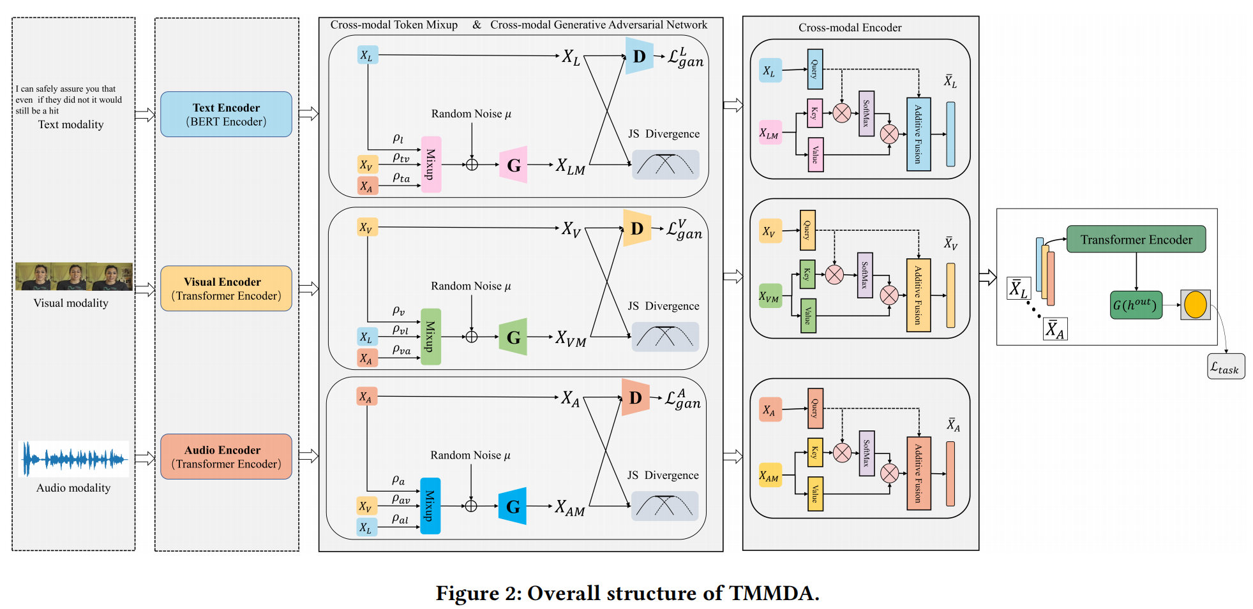
ChongqingUniversity of Technology
ATAI
AdvancedTechniqueof
Artificial Intelligence
ATAI
ChongqingUniversity _{AdvancedTechniqueof}
of Technology Artificial Intelligence
Overview

Slide 4
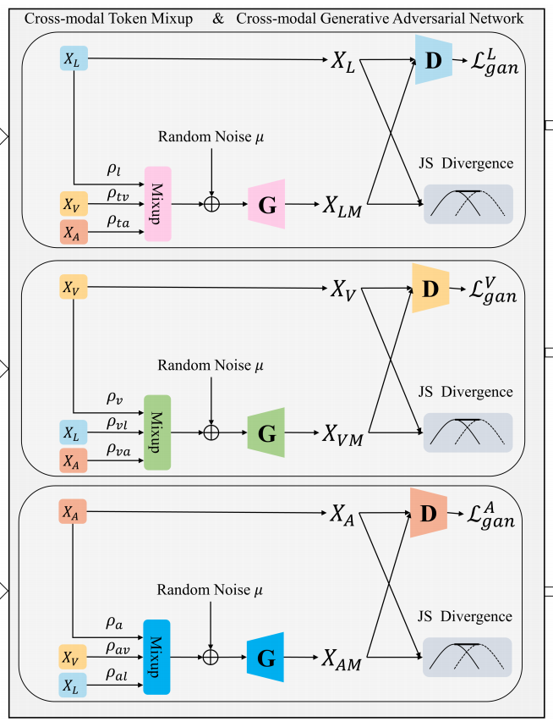
ChongqingUniversity of Technology
ATAI
AdvancedTechniqueof
Artificial Intelligence
ATAI
ChongqingUniversity _{AdvancedTechniqueof}
of Technology Artificial Intelligence
Method

Slide 5
ChongqingUniversity of Technology
ATAI
AdvancedTechniqueof
Artificial Intelligence
ATAI
ChongqingUniversity _{AdvancedTechniqueof}
of Technology Artificial Intelligence
Method

Slide 6
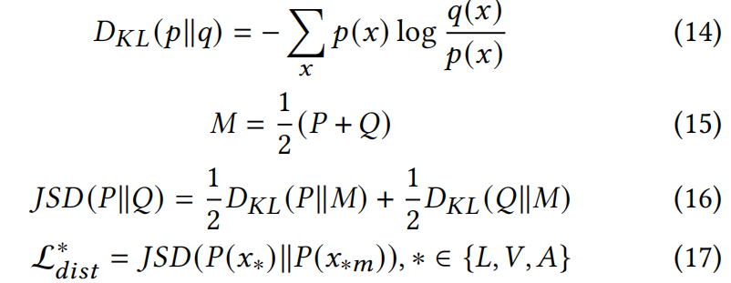
ChongqingUniversity of Technology
ATAI
AdvancedTechniqueof
Artificial Intelligence
ATAI
ChongqingUniversity _{AdvancedTechniqueof}
of Technology Artificial Intelligence
Method

Slide 7
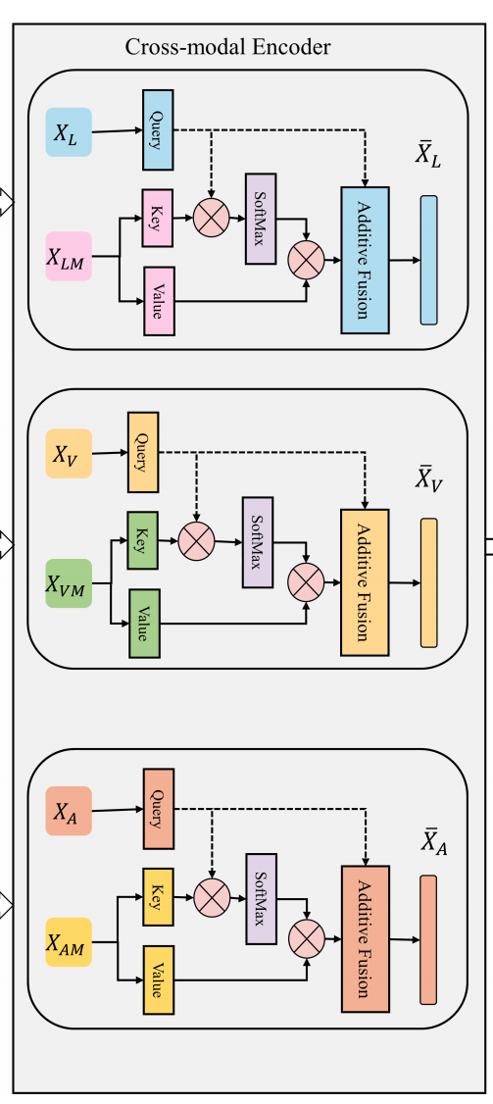
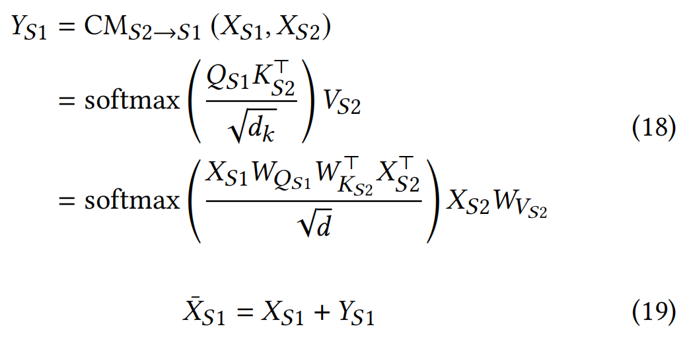
ChongqingUniversity of Technology
ATAI
AdvancedTechniqueof
Artificial Intelligence
ATAI
ChongqingUniversity _{AdvancedTechniqueof}
of Technology Artificial Intelligence
Method

Slide 8
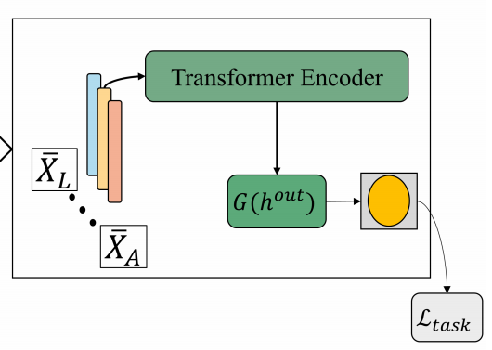
ChongqingUniversity of Technology
ATAI
AdvancedTechniqueof
Artificial Intelligence
ATAI
ChongqingUniversity _{AdvancedTechniqueof}
of Technology Artificial Intelligence
Method

Slide 9
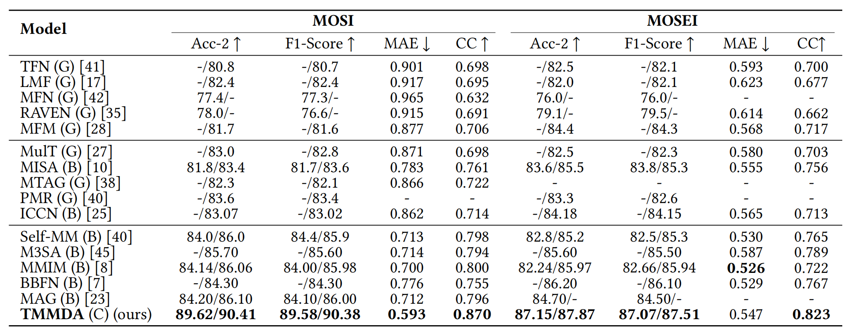
ATAI
AdvancedTechniqueof
Artificial Intelligence
ATAI
ChongqingUniversity _{AdvancedTechniqueof}
of Technology Artificial Intelligence
ChongqingUniversity of Technology
Experiments

Slide 10
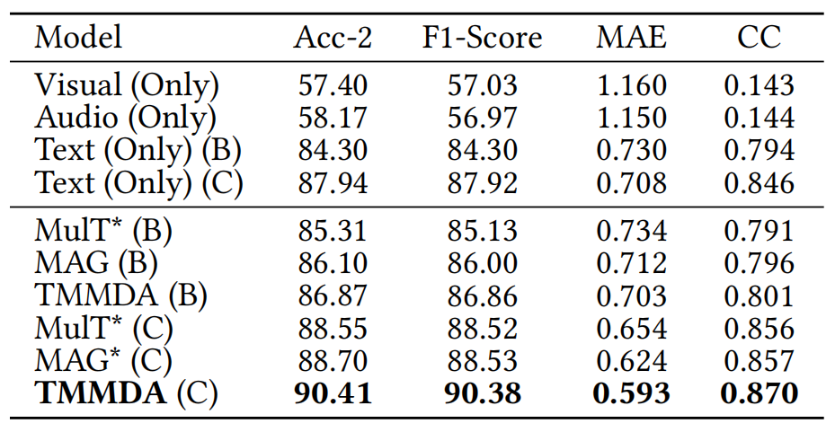
ATAI
AdvancedTechniqueof
Artificial Intelligence
ATAI
ChongqingUniversity _{AdvancedTechniqueof}
of Technology Artificial Intelligence
ChongqingUniversity of Technology
Experiments

Slide 11
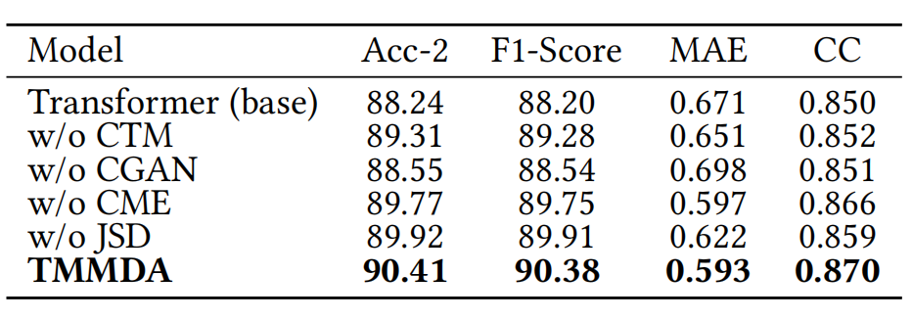
ChongqingUniversity of Technology
ATAI
AdvancedTechniqueof
Artificial Intelligence
ATAI
ChongqingUniversity _{AdvancedTechniqueof}
of Technology Artificial Intelligence
Experiments

Slide 12
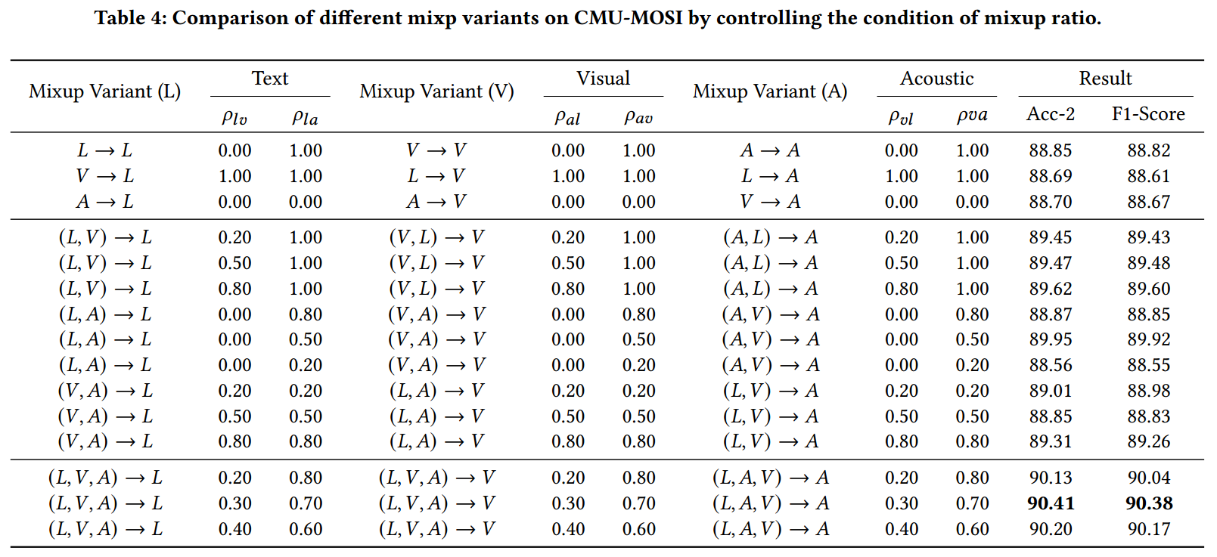
ChongqingUniversity of Technology
ATAI
AdvancedTechniqueof
Artificial Intelligence
ATAI
ChongqingUniversity _{AdvancedTechniqueof}
of Technology Artificial Intelligence
Experiments

Slide 13
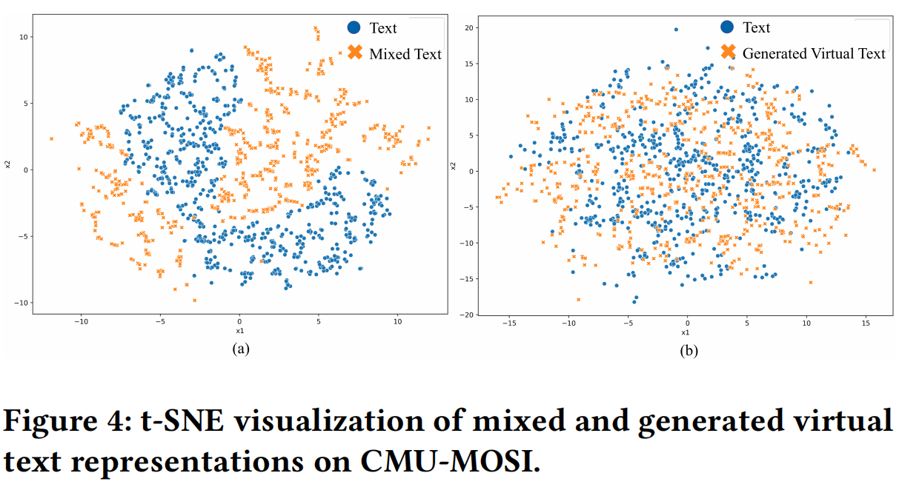
ChongqingUniversity of Technology
ATAI
AdvancedTechniqueof
Artificial Intelligence
ATAI
ChongqingUniversity _{AdvancedTechniqueof}
of Technology Artificial Intelligence
Experiments

Slide 14
ChongqingUniversity of Technology
ATAI
AdvancedTechniqueof
Artificial Intelligence
ATAI
ChongqingUniversity _{AdvancedTechniqueof}
of Technology Artificial Intelligence
Thanks!

